Slide 1




Java: Syntax, Basic Web
Conditions, Loops, Methods, Objects, Collections, Spring MVC
Java
Spring
SoftUni Team
Technical Trainers
Software University
http://softuni.bg

Slide 2


Table of Contents
Java Syntax
Variables and Operators
Conditions: if-else, switch
Loops: for, while, do-while, …
Methods, parameters, returning values
Objects and Classes
Arrays and Collections: ArrayList, Map, Set
Java Web with Spring MVC

Slide 3
Have a Question?
sli.do #tech-softuni

Slide 4

Welcome to Java!
IDEs, Comparison, Basic Syntax

Slide 5

Welcome to Java
Java is a statically-typed, object-oriented programming language
Very similar to C#
Variables’ types cannot be changed
In contrast to JavaScript and PHP where:
Code is not compiled
Types are dynamic

Slide 6
Hello World in Java
HelloJava class always stays in a file named HelloJava.java
HelloJava.java
The { stays on the same line
public class HelloJava {
public static void main(String[] args) {
System.out.println("Hello Java!");
}
}
Program entry point: main() method

Slide 7
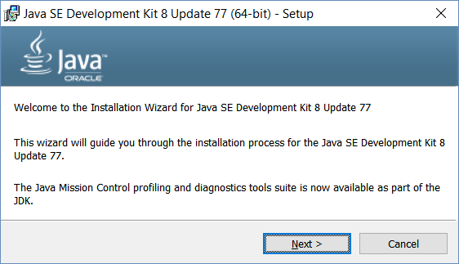
Installing Java
Download and install Java 8 SDK (JDK 8)
http://oracle.com/technetwork/java/javase/downloads/
Provides runtime environment (JRE) + compilers + tools
JRE (Java Runtime Environment)
https://java.com/en/download/
JRE is for end-users, not for devs
Developers should use JDK

Slide 8
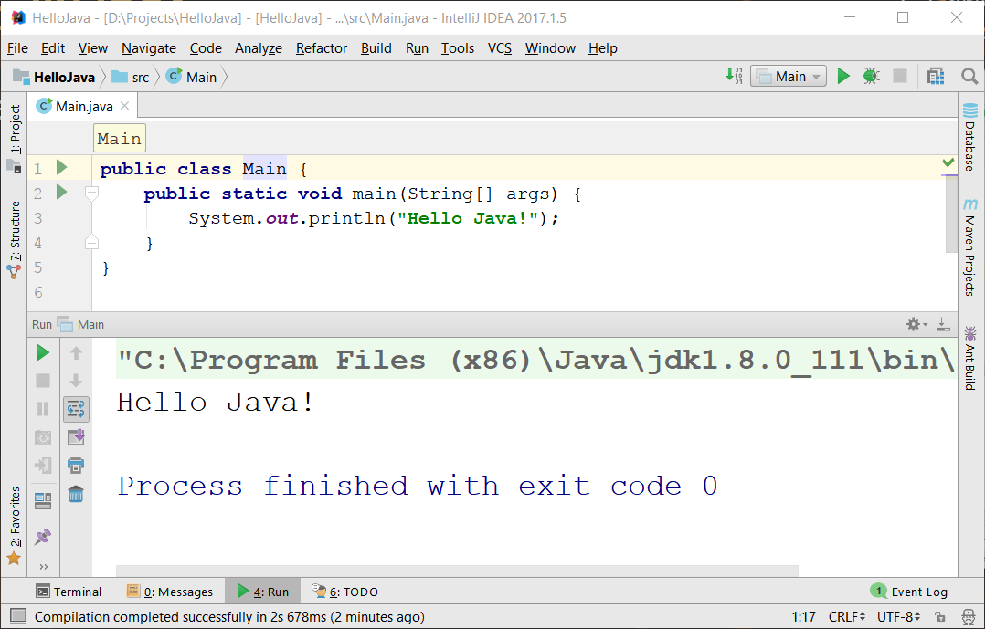
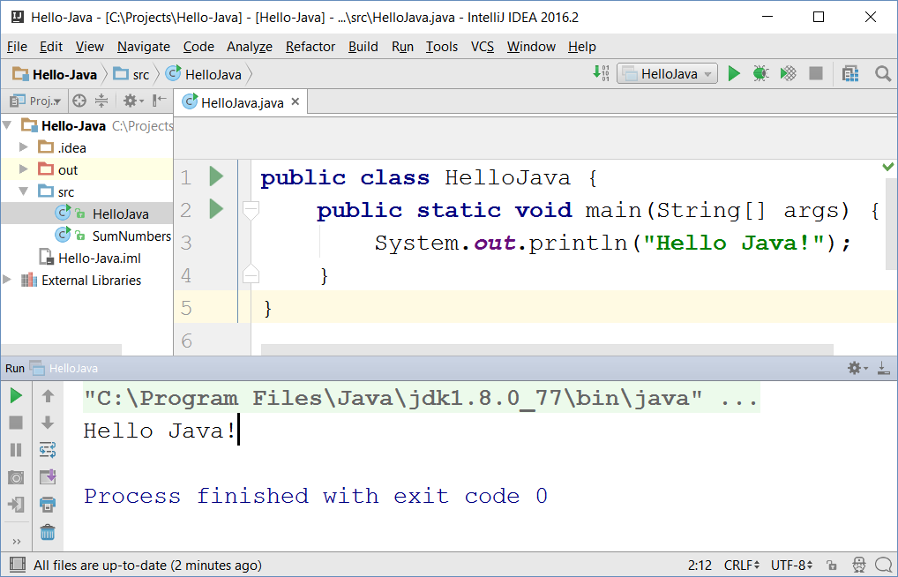

IntelliJ IDEA
JetBrains IntelliJ IDEA
Powerful Java IDE
Community edition (free)
Ultimate edition (commercial)

Slide 9
Basic Syntax
Variables, Operators

Slide 10
Variables and Operators in Java
Play with Java online:
www.javarepl.com
Define variables by their type
int i = 5; double d = 3; // i is integer, d is double
System.out.println(i + " ; " + d); // 5 ; 3.0
d = i * d; d++; // d = 16.0
System.out.println(d + 1); // 17.0
The ; separates multiple statements
String str = "Hello";
str = str + " Java";
System.out.printf("str = %s", str); // str = Hello Java
The %s is a string placeholder
System.out.print(s); // Compilation error: unknown symbol s

Slide 11
Problem: Sum Two Numbers
Write a Java program to sum two real numbers:
import java.util.Scanner;
public class SumTwoNumbers {
public static void main(String[] args) {
Scanner scan = new Scanner(System.in);
double num1 = Double.parseDouble(scan.nextLine());
double num2 = Double.parseDouble(scan.nextLine());
System.out.printf("Sum = %.2f", num1 + num2);
}
}
Check your solution here: https://judge.softuni.bg/Contests/Practice/Index/264#1

Slide 12
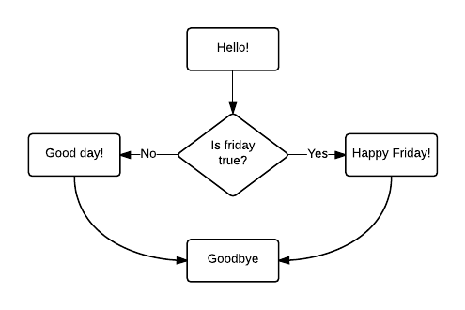
Conditional Statements
If/else, switch case

Slide 13
Conditions: if-else Statement
Java implements the classical if / if-else statements:
String currentDay = scan.nextLine();
String day = "Wednesday";
if (currentDay.equals(day)) {
System.out.println("It is Wednesday!");
} else {
System.out.println("Not Wednesday.");
}

Slide 14
Problem: Three Integers Sum
You are given 3 integers
Check whether the sum of two of them is equal to the third
Print the output in format a + b = c (where a ≤ b)
8 15 7
7 + 8 = 15
3 8 12
No
-5 -3 -2
-3 + -2 = -5
0 0 0
0 + 0 = 0
Check your solution here: https://judge.softuni.bg/Contests/Practice/Index/264#2

Slide 15
Solution: Three Integers Sum
public static void main(String[] args) {
Scanner scan = new Scanner(System.in);
int num1 = scan.nextInt();
int num2 = scan.nextInt();
int num3 = scan.nextInt();
if (!checkThreeIntegers(num1, num2, num3) &&
!checkThreeIntegers(num3, num1, num2) &&
!checkThreeIntegers(num2, num3, num1))
System.out.println("No");
}
Check your solution here: https://judge.softuni.bg/Contests/Practice/Index/264#2

Slide 16
Solution: Three Integers Sum (2)
static boolean checkThreeIntegers(
int num1, int num2, int sum) {
if (num1 + num2 != sum) {
return false;
}
if (num1 <= num2) {
System.out.printf("%d + %d = %d%n", num1, num2, sum);
} else {
System.out.printf("%d + %d = %d%n", num2, num1, sum);
}
return true;
}
%d ➔ int placeholder
%n ➔ new line
Check your solution here: https://judge.softuni.bg/Contests/Practice/Index/264#2

Slide 17
The switch-case Statement
Selects for execution a statement from a list depending on the value of the switch expression
int day = 3;
switch (day) {
case 1: System.out.println("Monday"); break;
case 2: System.out.println("Tuesday"); break;
case 3: System.out.println("Wednesday"); break;
…
case 7: System.out.println("Sunday"); break;
default: System.out.println("Error!"); break;
}

Slide 18

Loops
For, while, do-while, etc…

Slide 19
Loops: for, while, do-while, …
The for / while / do-while loops work as in C++, C# and Java
for (int i = 0; i <= 10; i++)
System.out.println(i); // 0 1 2 3 4 … 10
int count = 1;
while (count < 1024)
System.out.println(count *= 2); // 2 4 8 … 1024
String s = "ha";
do { System.out.println(s); s = s + s; }
while (s.length() < 10); // ha haha hahahaha

Slide 20
Problem: Sum N Integers in Java
import java.util.Scanner;
public class SumIntegers {
public static void main(String[] args) {
Scanner scan = new Scanner(System.in);
int n = Integer.parseInt(scan.nextLine());
long sum = 0;
for (int i = 0; i < n; i++) {
sum += Integer.parseInt(scan.nextLine());
}
System.out.println("Sum = " + sum);
}
}
5
10
20
30
40
-16
84
Check your solution here: https://judge.softuni.bg/Contests/Practice/Index/264#3

Slide 21
Methods in Java
Methods in Java hold a named piece of code
Can take parameters and return a result (strongly typed!)
Similar to functions in PHP / JS and methods in C#
static makes the method callable from main()
static int multiply(int a, int b) {
return a * b;
}
System.out.println(multiply(2, 3)); // 6 == 2 * 3
System.out.println(multiply(5)); // Compilation error

Slide 22
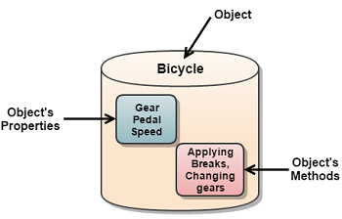
Objects and Classes
Definition, usage

Slide 23

Objects
In programming objects holds a set of named values
E.g. a rectangle object holds width and height
Creating a rectangle object:
Object name
rectangle
width = 5
height = 4
Object properties
The new operator creates a new object
Rectangle rectangle = new Rectangle();
rectangle.setWidth(5);
rectangle.setHeight(4);

Slide 24
Defining Classes
Rectangle.java
public class Rectangle {
private int width;
private int height;
public int getWidth() { return width; }
public void setWidth(int width) { this.width = width; }
public int getHeight() { return height; }
public void setHeight(int height) { this.height = height; }
}
Class declaration
Fields
Getters and setters

Slide 25
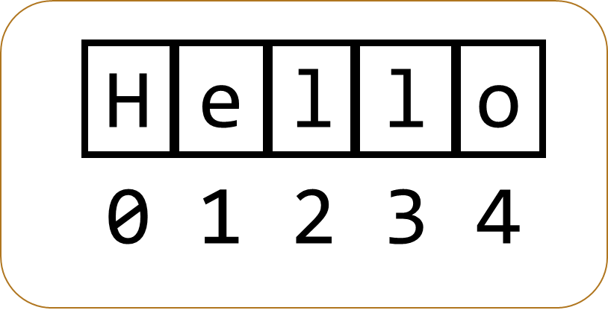
Strings
Declaring, comparisons, manipulation

Slide 26

Strings
Strings in Java
Know their number of characters: length()
Can be accessed by index: charAt(0 … length()-1)
Have reference type
Can have null (missing) value
Cannot be modified (immutable)
Most string operations return a new String instance
Low performance
Use the StringBuilder class to build stings quickly

Slide 27
Strings – Examples
String str = "SoftUni";
System.out.println(str);
for (int i = 0; i < str.length(); i++) {
System.out.printf("str[%d] = %s%n", i, str.charAt(i));
}
System.out.println(str.indexOf("Uni")); // 4
System.out.println(str.indexOf("uni")); // -1 (not found)
System.out.println(str.substring(4, 7)); // Uni
System.out.println(str.replace("Soft", "Hard")); // HardUni
System.out.println(str.toLowerCase()); // softuni
System.out.println(str.toUpperCase()); // SOFTUNI

Slide 28
Strings – Examples (2)
String firstName = "Steve";
String lastName = "Jobs";
int age = 56;
System.out.println(firstName + " " + lastName +
" (age: " + age + ")"); // Steve Jobs (age: 56)
String allLangs = "C#, Java; HTML, CSS; PHP, SQL";
String[] langs = allLangs.split("[, ;]+");
for (String lang : langs) {
System.out.println(lang);
}
System.out.println("Langs = " + String.join(", ", langs));
System.out.printf(" %n%n Software University ".trim());
Split by RegEx

Slide 29
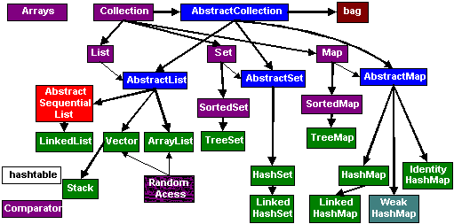
Collections
Arrays, ArrayList<>, HashSet<>, etc.

Slide 30
Arrays in Java
// Array holding numbers
int[] numbers = {1, 2, 3, 4, 5};
System.out.println(Arrays.toString(numbers));
// Array holding floating-point numbers
double[] numbers = {1.1, 5.44, 3.12, 4.4444, 5.0};
System.out.println(Arrays.toString(numbers));
// Array holding strings
String[] weekDays = {"Monday", "Tuesday", "Wednesday",
"Thursday", "Friday", "Saturday", "Sunday"};

Slide 31
Processing Array Elements
String[] capitals =
{"Sofia", "Berlin", "London", "Paris", "Moscow"};
capitals[0] = "SOFIA";
capitals[4] = null;
System.out.println(Arrays.toString(capitals));
// [SOFIA, Berlin, London, Paris, null]
for (String capital : capitals)
System.out.println(capital);
for (int i = 0; i < capitals.length; i++)
System.out.println(capitals[i]);
Traditional foreach loop
Traditional for-loop

Slide 32
Problem: Largest 3 Numbers
Write a program to read an array of numbers and find and print the largest 3 of them
10 30 15 20 50 5
20 30
10 5 20 3 20
50 30 20
30 20
20 20 10
Check your solution here: https://judge.softuni.bg/Contests/Practice/Index/264#5

Slide 33
Solution: Largest 3 Numbers
Scanner scan = new Scanner(System.in);
int[] nums = Arrays
.stream(scan.nextLine().split(" "))
.mapToInt(Integer::parseInt)
.toArray();
Arrays.sort(nums);
int count = Math.min(3, nums.length);
for (int i = 0; i < count; i++)
System.out.print(nums[nums.length - i - 1] + " ");
Java Stream API - similar to LINQ in C#
Check your solution here: https://judge.softuni.bg/Contests/Practice/Index/264#5

Slide 34
Collections: ArrayList<String>
ArrayList<String> names = new ArrayList<String>();
names.add("Peter");
names.add("Maria");
names.add("Katya");
names.add("Todor");
names.add("Nakov"); // Peter, Maria, Katya, Todor, Nakov
names.remove(0); // Maria, Katya, Todor, Nakov
names.remove(1); // Maria, Todor, Nakov
names.remove("Todor"); // Maria, Nakov
names.addAll(Arrays.asList("Alice", "Tedy"));
// Maria, Nakov, Alice, Tedy
names.add(3, "Sylvia"); // Maria, Nakov, Alice, Sylvia, Tedy
names.set(2, "Mike"); // Maria, Nakov, Mike, Sylvia, Tedy
System.out.println(names);

Slide 35
Collections: ArrayList<Integer>
// This will not compile!
ArrayList<int> intArr = new ArrayList<int>();
ArrayList<Integer> nums = new ArrayList<>(
Arrays.asList(5, -3, 10, 25));
nums.add(55); // 5, -3, 10, 25, 55
System.out.println(nums.get(0)); // 5
System.out.println(nums); // [5, -3, 10, 25, 55]
nums.remove(2); // 5, -3, 25, 55
nums.set(0, 101); // 101, -3, 25, 55
System.out.println(nums); // [101, -3, 25, 55]
Use wrapper Integer instead
Get item at index 0

Slide 36
HashSet<E> and TreeSet<E>
HashSet<E> doesn’t allow repetitions
TreeSet<E> keeps elements sorted
TreeSet<String> set = new TreeSet<String>();
set.add("Pesho");
set.add("Tosho");
set.add("Pesho");
set.add("Gosho");
set.add("Maria");
set.add("Alice");
set.remove("Pesho");
System.out.println(set); // [Alice, Gosho, Maria, Tosho]

Slide 37
Collections: Maps in Java
Maps in Java keep unique <key, value> pairs
HashMap<K, V>
Similar to Dictionary<T> in C#
Keeps a map of elements in a hash-table
Order of insertion is not preserved
TreeMap<K, V>
Similar to SortedDictionary<T> in C#
The elements are sorted by their key

Slide 38
HashMap<K, V> – Examples
Counting words occurrences in a list:
String[] words = { "yes", "hi", "hello", "hi", "welcome", "yes", "yes", "welcome", "hi", "yes", "hello", "yes" };
HashMap<String, Integer> wordsCount =
new HashMap<String, Integer>();
for (String word : words) {
Integer count = wordsCount.get(word);
if (count == null)
count = 0;
wordsCount.put(word, count+1);
}
System.out.println(wordsCount);
// {hi=3, yes=5, hello=2, welcome=2}

Slide 39
TreeMap<K, V> – Examples
Tracking students and their grades
HashMap<String, ArrayList<Integer>> grades = new HashMap<>();
grades.put("Peter", new ArrayList<>(Arrays.asList(5)));
grades.put("George", new ArrayList<>(Arrays.asList(5, 5, 6)));
grades.put("Maria", new ArrayList<>(Arrays.asList(5, 4, 4)));
grades.get("Peter").add(6); // add 6 to Peter's grades
grades.get("George").add(6);
for (String key : grades.keySet()) {
System.out.println("" + key + " -> " + grades.get(key));
}

Slide 40
Problem: Sums by Town
You are given a sequence of lines, each holding town + income
Write a Java program to sum the incomes for each town
4
Sofia | 200
Varna | 120
Pleven | 60
Varna | 70
Towns can appear multiple times
Pleven -> 60.0
Sofia -> 200.0
Varna -> 190.0
Order the towns by name
Check your solution here: https://judge.softuni.bg/Contests/Practice/Index/264#6

Slide 41
Solution: Sums by Town
TreeMap<String, Double> sumsByTown = new TreeMap<>();
for (int i = 0; i < n; i++) {
String[] tokens = scanner.nextLine().split("\\|");
String town = tokens[0].trim();
double income = Double.parseDouble(tokens[1].trim());
if (sumsByTown.containsKey(town)) {
sumsByTown.put(town, sumsByTown.get(town) + income);
} else {
sumsByTown.put(town, income);
}
}
for (String key : sumsByTown.keySet()) {
System.out.println(key + " -> " + sumsByTown.get(key));
}
Check your solution here: https://judge.softuni.bg/Contests/Practice/Index/264#6

Slide 42



Java Web
Hibernate, Spring MVC, Thymeleaf

Slide 43

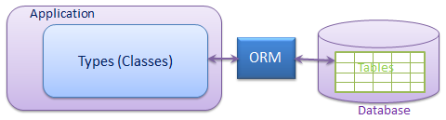

Hibernate ORM
Object-Relational Mapping (ORM) Framework for Java
Replace DB query access with object functions
Persistence
Change object in-memory ➔ changes it in DB
Add object to collection ➔ add it to DB
High Performance
Lazy-loading
Eager loading by request

Slide 44
Hibernate: Model - Fields
Classic Java OOP with Hibernate annotations:
@Entity
@Table(name = "users")
public class User {
private Integer id;
private String email;
private String fullName;
private String password;
}

Slide 45
Hibernate: Model - Properties
Classic Java OOP with Hibernate annotations:
@Column(name = "email", unique = true, nullable = false)
public String getEmail() {
return email;
}
public void setEmail(String email) {
this.email = email;
}

Slide 46

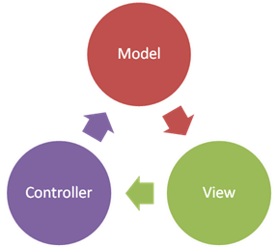

Spring MVC
Open Source Web MVC framework
Developed by Pivotal Software
Configuration with Spring Boot
Convention-over-configuration
Rapid application development
Create production-grade applications that you can “just run”
Automatically configure Spring

Slide 47
Spring Annotations
Spring uses strongly-typed Annotations
Syntax highlighting + error checking
Annotations describe the code below them
@Controller
public class HomeController {
…
}
Versatile Access Control
@PreAuthorize("hasRole('ROLE_ADMIN')")
public String adminPanel(Model model) {
…
}

Slide 48
Spring Controllers
Defined with the @Controller annotation:
Controllers can contain multiple actions on different routes.
@Controller
public class HomeController {
…
}

Slide 49
Controller Actions
Annotated with with @RequestMapping(…)
Or
@RequestMapping("/home")
public String home() {
return "home-view";
}
@GetMapping("/home")
public String home(Model model) {
model.addAttribute("view", "home");
return "base-layout";
}

Slide 50
Processing GET Requests
Easier way to create route for a GET request:
This is alias for RequestMapping with method GET
@GetMapping("/home")
public String home() {
return "home-view";
}

Slide 51
Processing POST Requests
Similar to the GetMapping there is also an alias for RequestMapping with method POST:
Similar annotations exist for all other types of request methods
@PostMapping("/register")
public String register() {
…
}

Slide 52


Thymeleaf
Thymeleaf is a view engine used in Spring
It allows us to:
Use variables/collections in our views
Execute operations on our variables
Iterate over collections
Notes:
http://www.thymeleaf.org/doc/tutorials/3.0/usingthymeleaf.html

Slide 53
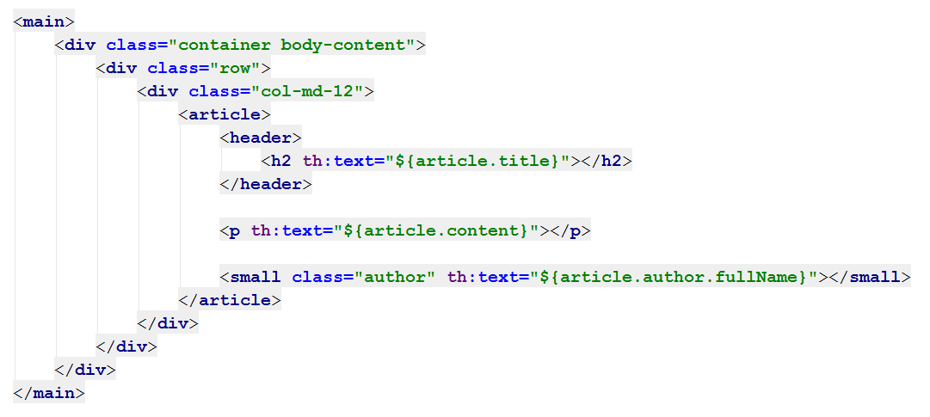
Thymeleaf: View Templates
Thymeleaf syntax
HTML
Syntax
Thymeleaf syntax
Thymeleaf syntax

Slide 54
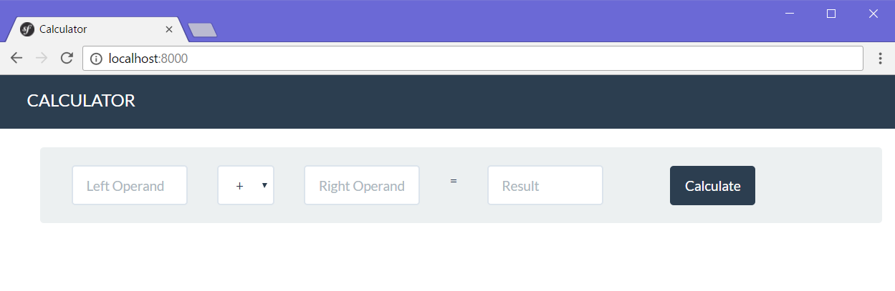
Web application with Spring MVC
Live Exercises in Class (Lab)

Slide 55

Summary
Java is a statically-typed language
Java programs consist of classes
Program logic (variables, conditions, loops) are similar to C# / PHP / JavaScript
Arrays in Java hold sequences of elements
Java collections: list, set, map { key → value }
Objects in Java are class instances
Java is object-oriented language: relies on objects, classes, interfaces, methods, etc.

Slide 56
Summary (2)
Build robust web applications with Java, using
Spring MVC
Open Source MVC Web Framework for Java
Controller handling, annotations
Hibernate
ORM framework for Java
Thymeleaf
Powerful view engine
Variables, Iteration, Conditions

Slide 57







Java: Syntax, Basic Web
https://softuni.bg/courses/software-technologies

Slide 58
License
This course (slides, examples, demos, videos, homework, etc.) is licensed under the "Creative Commons Attribution-NonCommercial-ShareAlike 4.0 International" license

Slide 59





Trainings @ Software University
Software University Foundation – softuni.org
Software University – High-Quality Education, Profession and Job for Software Developers
softuni.bg
Software University @ Facebook
facebook.com/SoftwareUniversity
Software University Forums – forum.softuni.bg

